Slide 1

Deploy Your First App on Cloud Foundry
Hands-on Workshop

Slide 2
Objectives
Gaining first hand experience with the workflow of deploying applications into a Cloud Foundry cluster

Slide 3
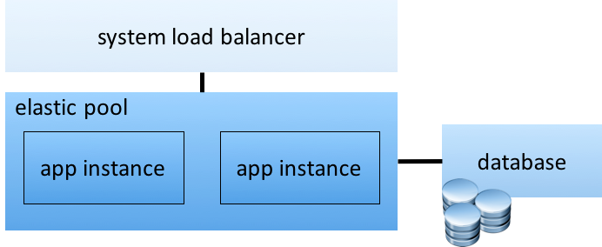
Typical Web Application

Slide 4
Typical Workflow deploying
# to target and login to cloud foundry
helion target https://hcfXXX.helion-dev.com
helion login
# to create and boot the app for the first time
helion push myapp -–instances 2 -–mem 64M –path ../code
# to create the database and bind it to the app
helion create-service mysql -–name mydb -–bind myapp
# update live app with new code
helion update myapp -–path ../code

Slide 5
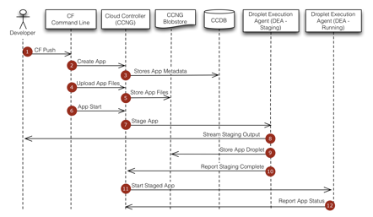
Cloud Foundry App Deployment

Slide 6
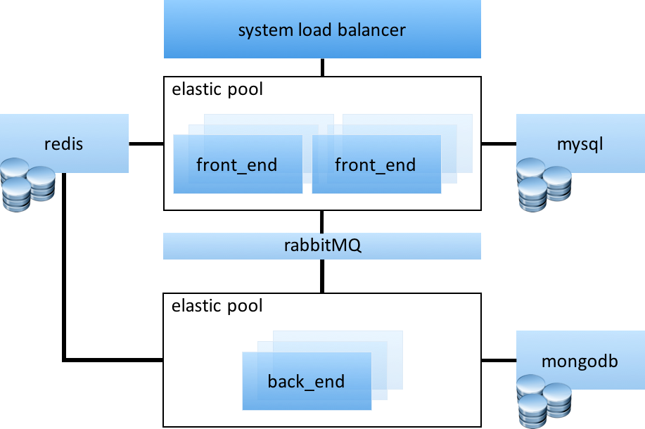
More Complicated

Slide 7
More Complicated, More of the Same!
# create the front end and backend apps
# front end is small but multi-instance
helion push fe -–instances 8 -–mem 64M -–path ../fe_code
helion push be -–instances 2 -–mem 256M -–path ../be_code
# create the services and bind per spec
helion create-service mysql -–name mysql -–bind fe
helion create-service mongodb -–name mongo -–bind be
helion create-service rabbit -–name rabbit -–bind fe
helion create-service redis -–name redis -–bind fe
helion bind-service redis be
helion bind-service rabbit be
# to perform an update of code
helion update fe -–path ../new_fe_code
helion update be -–path ../new_be_code

Slide 8
Prerequisites
Laptop running Windows, Linux, MacOS
GitHub client installed
https://help.github.com/articles/set-up-git/

Slide 9
Helion Cloud Foundry
40x micro clusters, containing:
Controller, router, DEA, HM, MySQL, Redis
Running on single OpenStack VM in hpcloud.com
Naming convention:
https://hcfXXX.helion-dev.com
XXX == your cluster id, 3 digits [001-040]
Credentials:
UID == dev PWD == password1234!

Slide 10
Getting Ready
Install the helion CLI for your platform:
Overview: http://docs.hpcloud.com/helion/devplatform/1.1/als/client/download
Linux64: http://clients.als.hpcloud.com/helion-1.1.0-linux-glibc2.3-x86_64.zip
Linux32: http://clients.als.hpcloud.com/helion-1.1.0-linux-glibc2.3-ix86.zip
MacOS: http://clients.als.hpcloud.com/helion-1.1.0-macosx10.5-i386-x86_64.zip
Windows: http://clients.als.hpcloud.com/helion-1.1.0-win32-ix86.zip

Slide 11
Validating Your Setup
# set target to your cluster endpoint
helion target https://hcfXXX.helion-dev.com
# login using uid:dev pwd:password1234!
helion login
# list cluster info
helion info
# list existing applications
helion apps

Slide 12
Your first application
# create a working directory
mkdir ~/workshop
cd ~/workshop
# clone repo as starting point
git clone https://github.com/hcf-workshop/cf-node-app.git
# Very simple node.js application:
# server.js
# package.json

Slide 13
To deploy your first application...
# Create a manifest.yml file using your favorite editor
# manifest.yml content
---
# This is an extremely basic manifest file.
# Note that the name is always required
# while other fields are optional.
applications:
- name: cf-node-app
mem: 128M

Slide 14
To deploy your first application...
# cd ~/workshop/cf-node-app
# -n is no questions asked :)
helion push –n
# when done, open your application
https://cf-node-app.hcfXXX.helion-dev.com
# check the portal and look at the log stream and files
https://hcfXXX.helion-dev.com

Slide 15
Ready for your second app?
This application will bind to a MySQL database
To get started:
cd ~/workshop
git clone https://github.com/hcf-workshop/cf-node-mysql-app.git
cd ~/workshop/cf-node-mysql-app

Slide 16
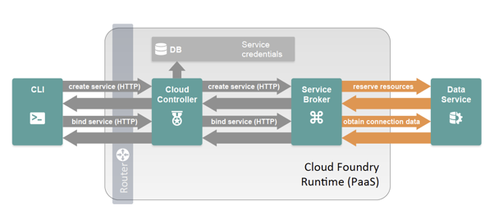
Creating and Binding a Service

Slide 17
Deploy app, bind it with a service
# create manifest.yml file, first iteration
---
applications:
- name: cf-node-mysql-app
mem: 128M
# deploy but do not start
helion push -n --no-start

Slide 18
How the app uses the database?
var services = process.env.VCAP_SERVICES;
services = JSON.parse(services);
var credentials = services.mysql[0].credentials;
var dbname = credentials.name;
var hostname = credentials.hostname;
var user = credentials.user;
var password = credentials.password;
var port = credentials.port;

Slide 19
Create & Bind the Service to the App
# list available services
helion services
# create the service
helion create-service mysql cf-node-mysql-app-db
# bind the the service to the application
helion bind-service cf-node-mysql-app-db cf-node-mysql-app
# start the application
helion start cf-node-mysql-app

Slide 20
Look at your app...
# dump the environment variables of the app
helion env cf-node-mysql-app
# dump the logs of your application from the command line
helion logs cf-node-mysql-app

Slide 21
Now do it again using a manifest
# delete app
helion delete cf-node-mysql-app
# update manifest.yml to be like this
---
applications:
- name: cf-node-mysql-app
mem: 128M
services:
${name}-db:
type: mysql

Slide 22
Rinse and repeat...
# deploy again
cd ~/workshop/cf-node-mysql-app
helion push -n

Slide 23
If you have time...
Feel free to play around!
Suggestion:
https://github.com/cloudfoundry-samples/fib-cpu
# scale to 2 instances
helion scale <app-name> --instances 2
# list instances
helion instances <app-name>

Slide 24
Thank you!
I hope you had fun
and
learned something too!

